Slide 1
Level Operations
Lab1 question 1: Return np.clip(image + c, 0, 255)
Use one line functions instead of for loops. For 4 and 5, use slice.
CSCI 4150/6050: Computer Vision
His tool is Affinity photo 2, works like photoshop
Slides Credit: Dr. Bryan Morse from BYU

Slide 2



Level Operations
Simplest enhancement:
process each point independent of others
Output value is a function of the input value only
“Point operations” or “level operations”
Eg making an image brighter, each pixel is modiifed independent of the surrounding ones.

Slide 3
Level Operations
Scaling ie not making the image bigger but increasing the range of valaues that can be used?
Simple idea with lots of applications:
  Brightness
  Contrast
  Scaling
  Clipping
  Negatives
  Thresholding
  Quantization
  Logarithmic encoding
  Gamma correction
  Windowing
  Equalization
  and many more…

Slide 4
We are staying in grayscale now for simplicity, but we will get to color next time.

Slide 5



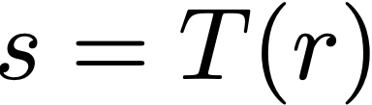

Level Operations
Values here are pixel values between 0 and 255. The curve defines a new pixel value for the old pixel values r
Output value is a function of the input value
for all pixel positions x, y:
out[x,y] = func(in[x,y])

Slide 6

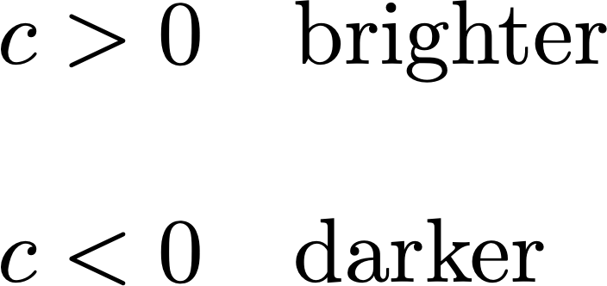

Brightness
Here simply add a constant value to the input pixel to increase output, ie brightness. The blue line is the identiy curve, ie default, then the red is the brighter curve which maxs out at 255 (ie highest pixel level)
Im = im + c, np.clip(im, 0, 255)
Numpy code to implement this and use np.clip around output so it stays btwn 0 and 255
s
r

Slide 7

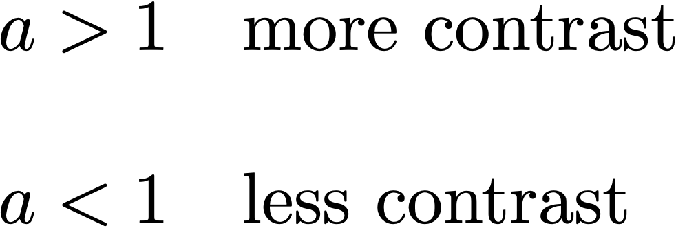
Contrast
Numpy: im = im*a, then clip
As we clip out stuff, we lose information at the top and bottom
s
Simply multiplication of input value by a constant or percentage
r

Slide 8

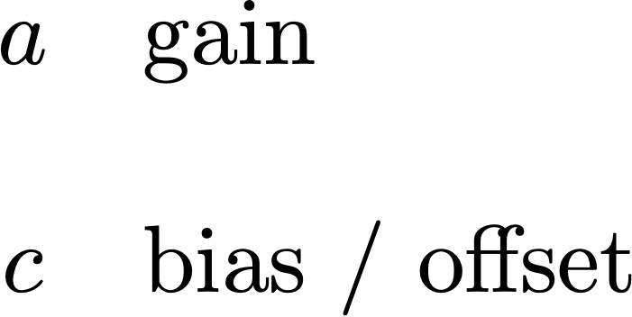

Linear Operations

Slide 9
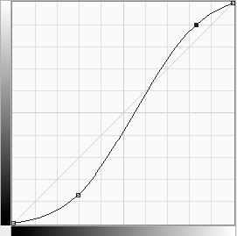
Contrast Enhancement
Contrast enhancement makes differences more distinguishable
Trades off decreased contrast in some part(s) of the range for increased contrast in the range we're interested in
If we plot the function,
  Slope > 1 means enhancement
  Slope < 1 means reduction

Slide 10
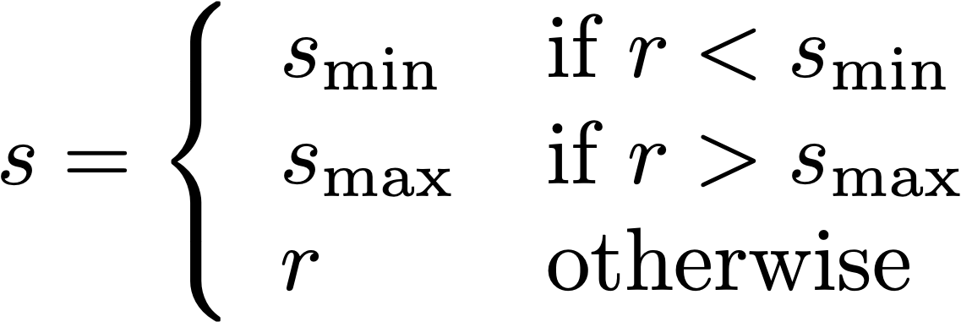
Clipping
Clipping to a limited range:
If input or output gets too high or low, set it to max or min values to avoid too much loss.
np.clip(img, 0, 255) – always wrap images in this function.
Very common to clip to [min,max] of the range
to avoid unsigned wrap-around

Slide 11
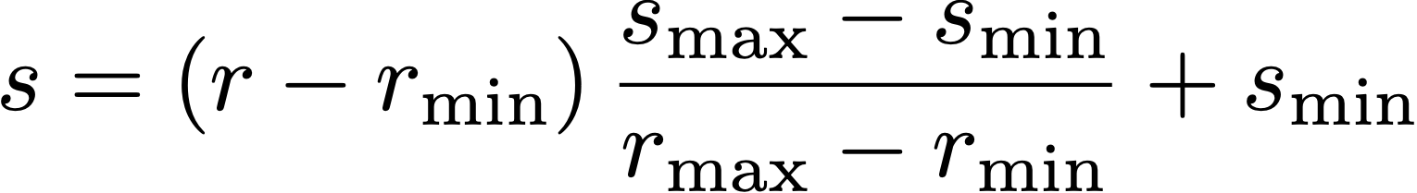
Scaling
Scaling linearly from one range to another:
Eg scaling from 16bits to 8bits

Slide 12


Negative
Inverting the color scale, ie darkest is brightest and vice versa
s
or
r

Slide 13
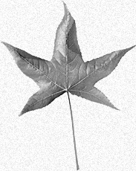
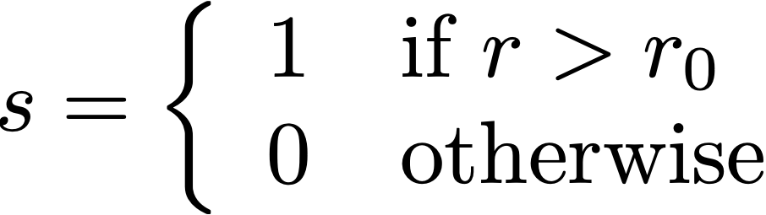

Thresholding
Making everithing either 1 or 0, ie white or black., used mostly in document prcessing
For text or for medical image processing.
Binarization based on a threshold
s
r

Slide 14
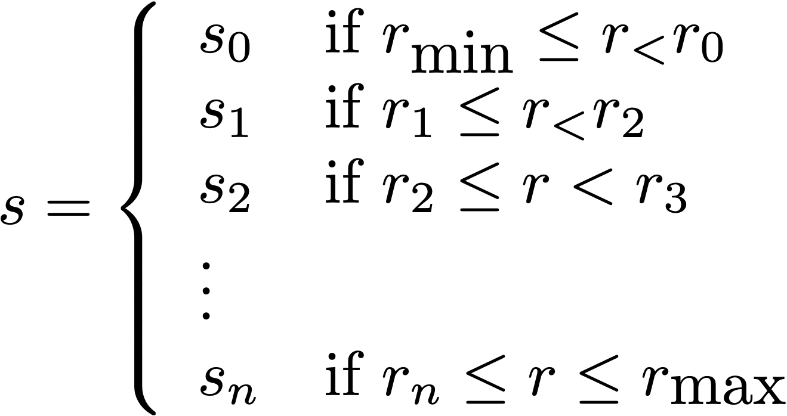
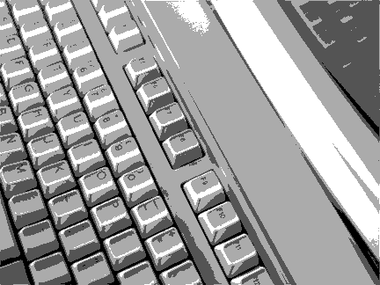
Quantization
Sifferent value ranges have different colors, eg 5 ranges here.
s
r

Slide 15
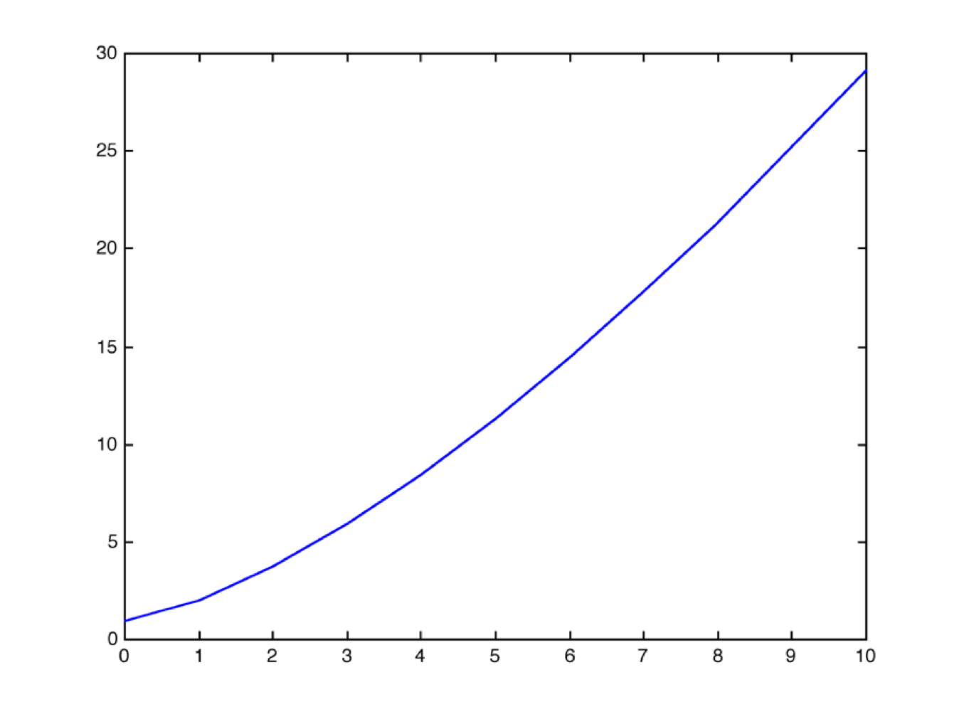

Gamma Responses
Many devices have a nonlinear response:
For a CRT, the intensity is related to the voltage by
The exponent is often called the “gamma” of the device

Slide 16
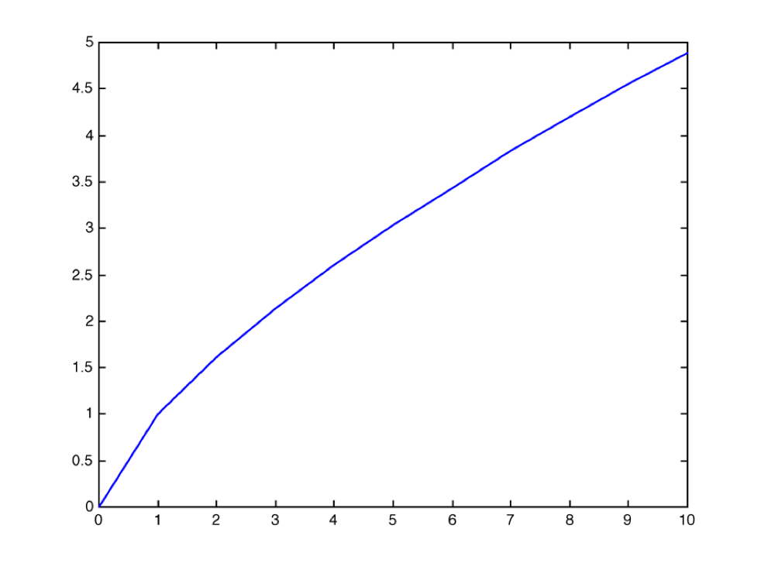
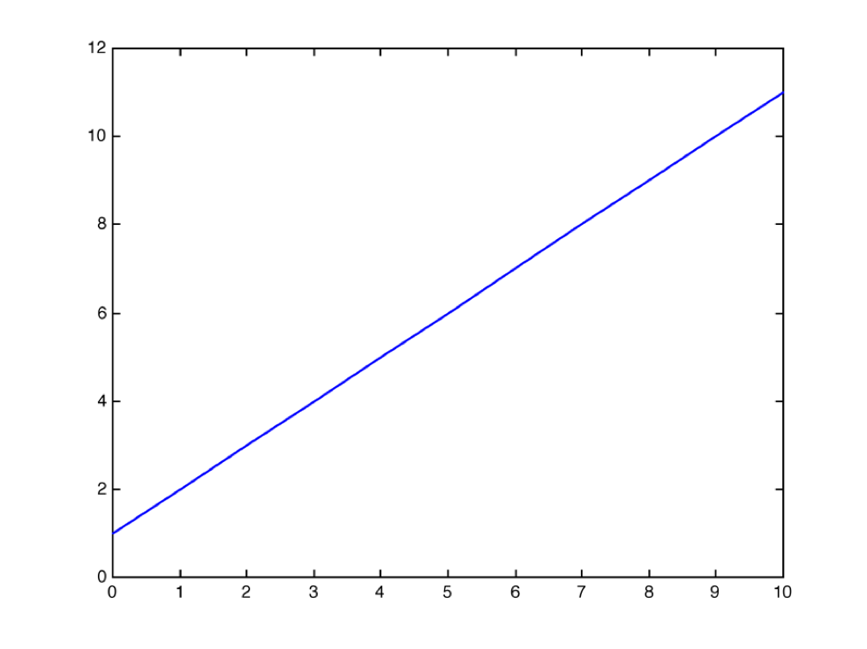
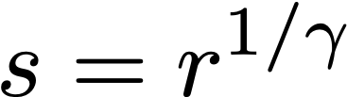
Gamma Correction
Preprocess
Device
Result

Slide 17
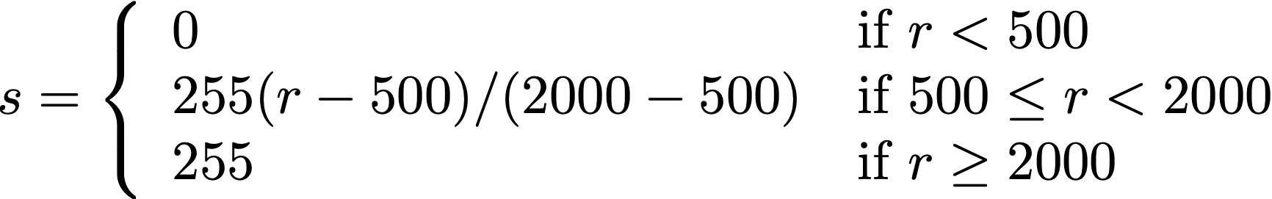
Windowing
Windowing is enhancement of one part
of the image range
Example:
Displaying 12-bit X-rays on an 8-bit screen
  Simple: scale [0,4095] to [0,255] by dividing by 16
  Better: if you know that what you’re interested in is in the range [500,2000], enhance that part of the range

Slide 18
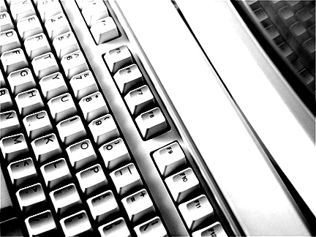
Windowing
Another example:
  Want to better see the reflection of the keys
  Enhance this range at expense of contrast in brighter or darker areas
If the full range is already used, contrast enhancement is a
zero-sum game

Slide 19
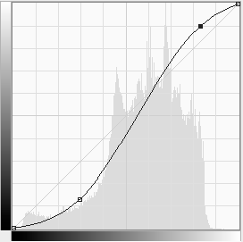
Histogram Equalization
It looks at the pixel value, and lowers contrast in areas where we have the fewest pixel values and vice versa.
Uses normalization summation curve.
Can try to automatically optimize contrast by allocating according to brightness distribution (histogram)
This is called histogram equalization because it tries to spread contrast evenly
Strong discrimination of detail, but not always good “real looking” result

Slide 20
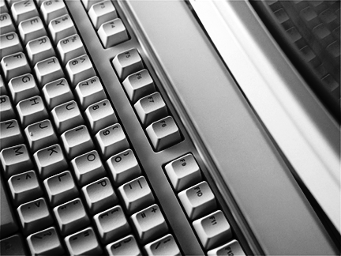
Histogram Equalization

Slide 21
Let’s play around with these functions in photoshop…

Slide 22
What would these functions look like in Numpy?

Slide 23
Image Arithmetic
Involve multiple images
Apply a function pairwise (or more) to the pixels in the input images
Possibilities:
add, subtract, and, or, min, max, …
Image 1
Image 2
Out
for all pixel positions x, y:
out[x,y] = func(in1[x,y],in2[x,y],…)

Slide 24
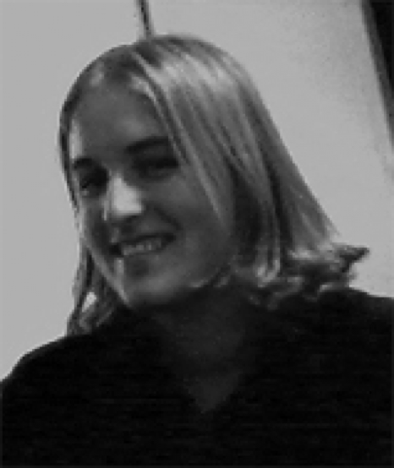
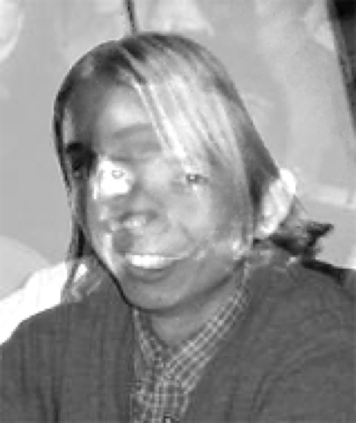
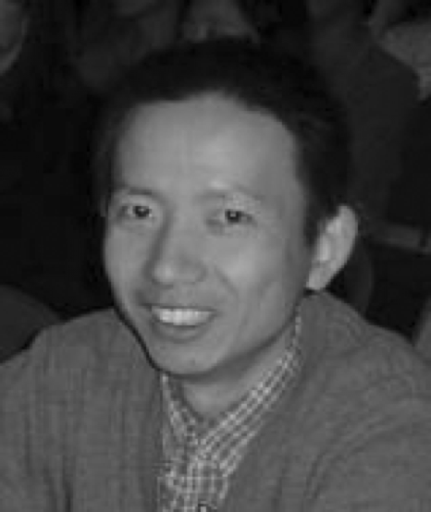
Addition
Can be used for double exposures or composites
Often a weighted blend
Used for long exposure photography, ie camera in same position taking pictures for a while and the
Average is taken. Eg a beautiful street with just lines of fast cars.

Slide 25
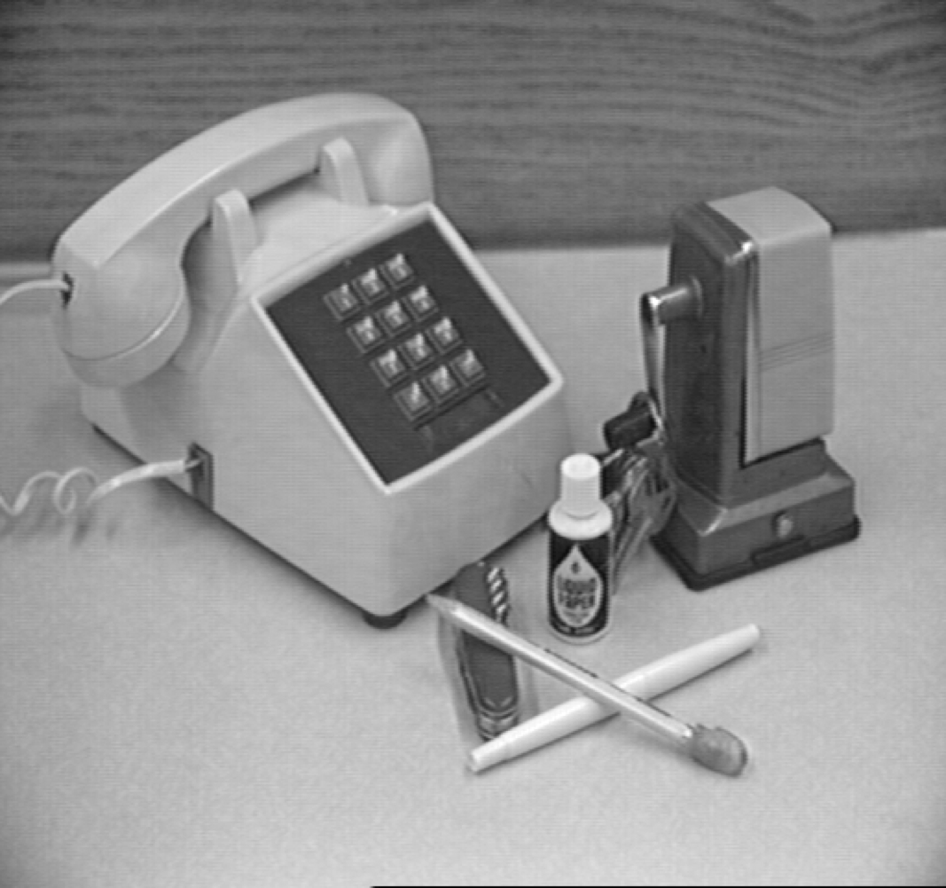
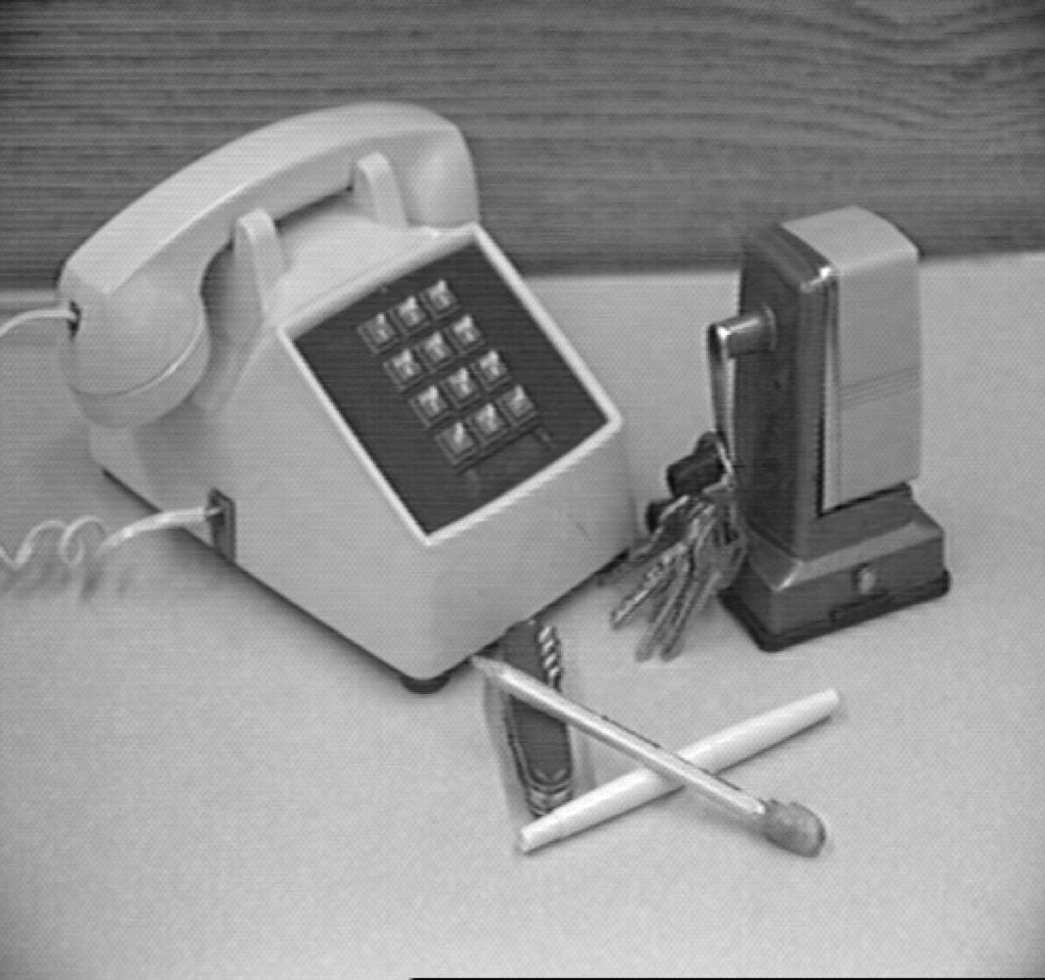
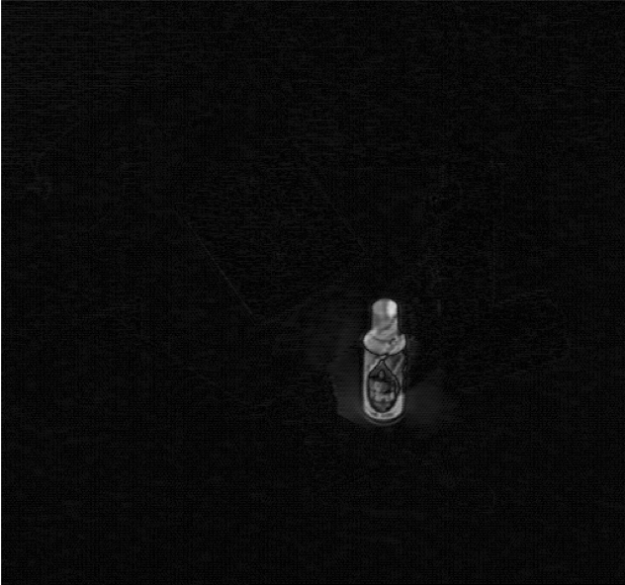
Subtraction
Eg in security cameras to determine if someone ot motion is introduced
Into a video or image.
Eg with mp4 storages, where a video is 8% same background, mp4 stores
The difference between these images instead of same pixels every image
To reduce storage
Numpy: np.abs(im1-im2)
Useful for finding changes between images
Often more useful to use absolute difference
-
=

Slide 26
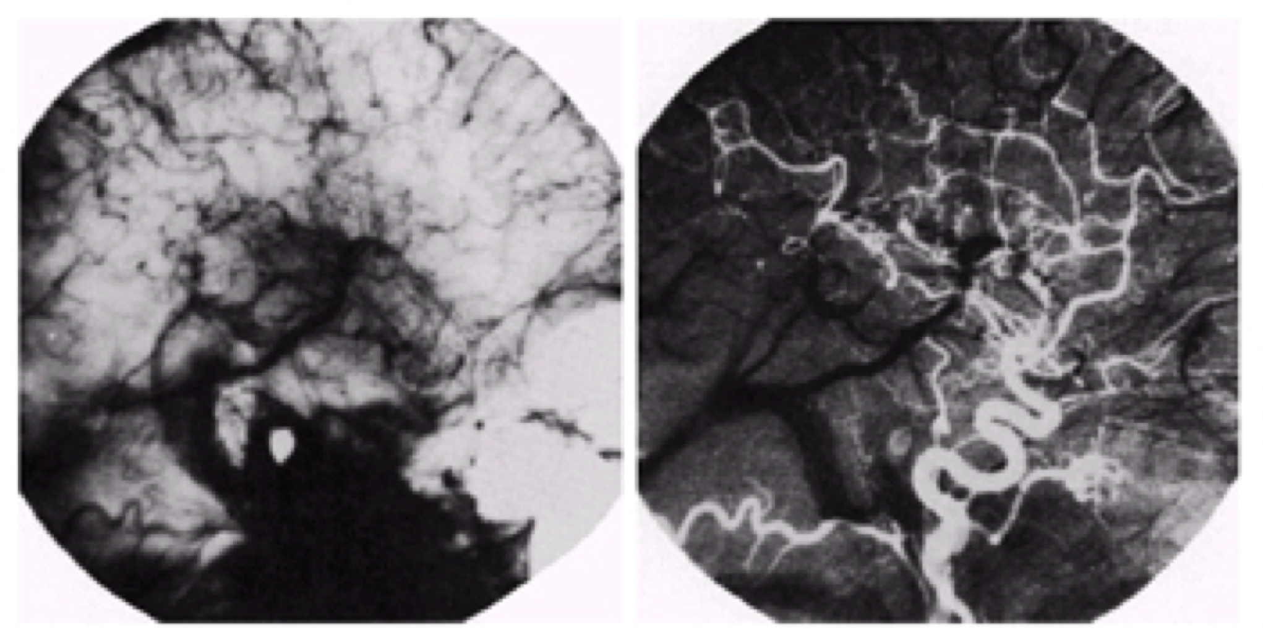
Digital Subtraction Angiography
Take an x-ray
Inject patient with
radio-opaque dye
(“don’t move!”)
Take another x-ray
Subtract the two

Slide 27
Motion
Use differencing to identify motion in an otherwise unchanging scene
(object motion, not camera motion)
  Basis for motion tracking techniques in computer vision
Use overall shift (minimum difference) for tracking camera motion
  Part of a larger process called a “match move” in film making
  Essential for inserting CGI into a real scene with a moving camera
  (the virtual camera has to move the same way the physical camera did)
Useful for video compression
  Only encode the difference between frames
  Motion detection/prediction used in video compression (MPEG, etc.)

Slide 28
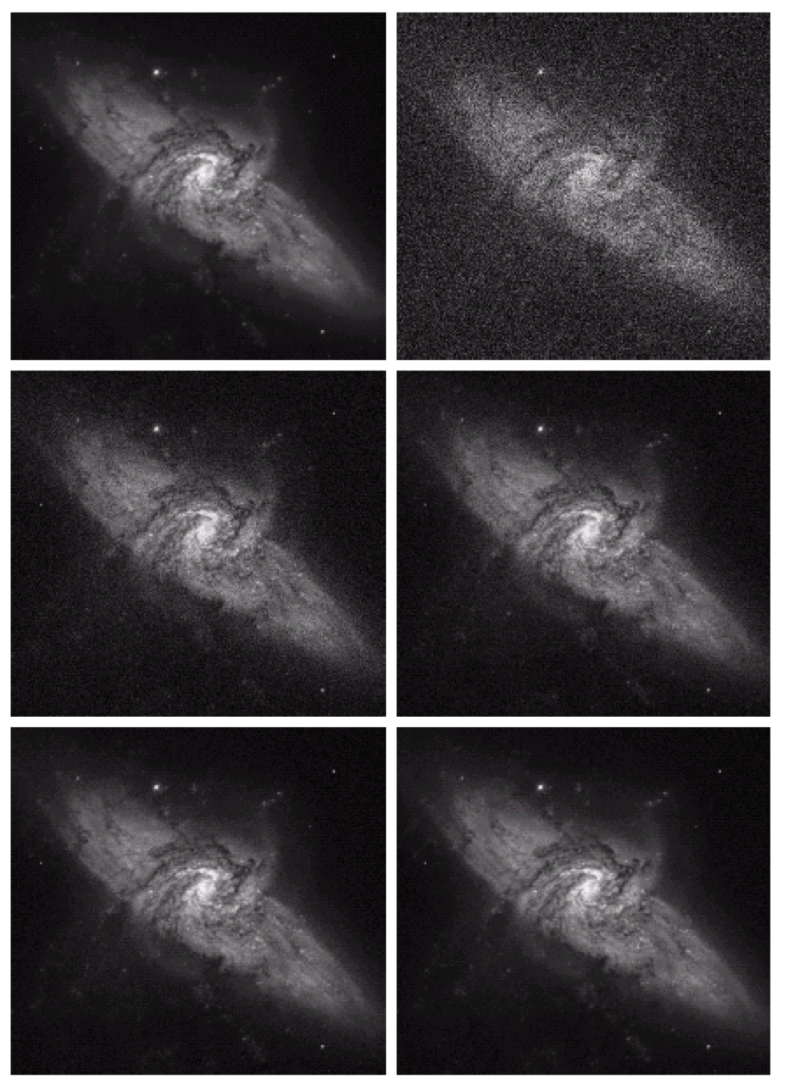
Image Averaging
Average multiple pictures of the same static scene to reduce noise
Similar in principle to acquiring the image for a longer duration
8
16
64
128

Slide 29
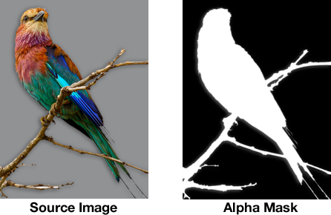
Alpha Masks
In this case we care about the bird, we mask it out, and use the bird ie alpha mask on
Image ie what green screens use. Ie take everything except green screen and blend with a
different background
alpha_arr
Imr1
Img2
alpha_arr * im1 _ (1-alpha_arr0 * im2
Blending often uses an alpha mask
Sometimes also called a matte
Often stored with image as an extra alpha channel
0 = transparent,
1 = opaque
Alpha blend – linear combination

Slide 30
Alpha Blending
Use per-pixel weights to blend two images:
Or most commonly:
Useful for transparency, compositing, etc.

Slide 31
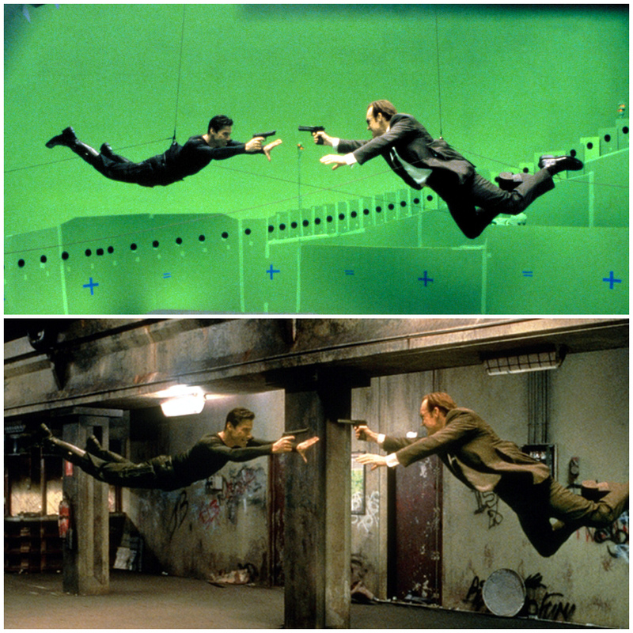
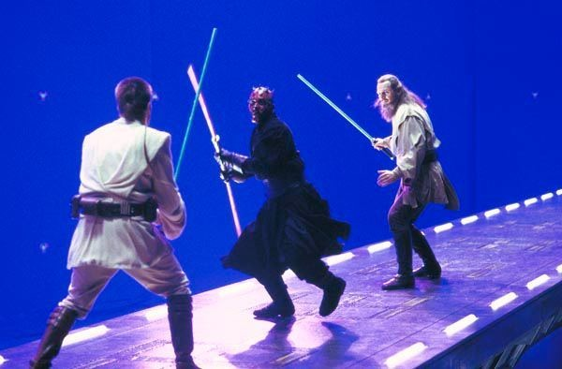
Application: Blue/Green Screening
Green is prefered to blue these days because blue was in so many things, eg eyes

Slide 32
Application: Green Screening
Film against green background
Mask out the green parts
Use fractional alpha values for partial-pixel effect
“Decontaminate” the green halo
Store in RGBA format
Composite onto background using alpha blending

Slide 33
Let’s try it in NumPy…

Slide 34
Coming up...
Color image processing
Neighborhood operations:
    noise reduction
    sharpening
    edge detection

Slide 35
Level Curve Maker
s
r

